Slide 1
LINUX MINT OS
Hilman Maulana Anhar
Muhamad Dani Setiawan
1SC8

Slide 2

LINUX MINT

Slide 3
INTRODUCTION
Background
Linux is the name given to the Unix type computer operating system. Linux is one example of the results of the development of free software and the main open source. Like free software and other open sources in general, the Linux source code can be modified, used and redistributed freely by anyone, one of the most popular Linux distributions is Linux Mint OS.

Slide 4
What is ?
OPERATING SYSTEM
LINUX OS
LINUX MINT OS
An operating system (OS) is the program that, after being initially loaded into the computer by a boot program, manages all the other programs in a computer. The other programs are called applications or application programs. The application programs make use of the operating system by making requests for services through a defined application program interface.
Linux is an operating system (OS) created in 1991 by Linus Torvalds. Linux is used by millions of people around the world. Many computer users like the operating system because it is highly customizable. Programmers can even modify the source code and create their own unique version of the Linux operating system. Since the Linux OS is freely distributed, there are no licensing fees. This means Linux servers can host hundreds or even thousands of websites at no additional cost.
Linux Mint is a free and open source operating system (OS) distribution based on Ubuntu and Debian for use on x-86 x-64-compatible machines. Mint is designed for ease of use and a ready-to-roll out-of-box experience, including multimedia support on desktops. The operating system is easier to install than most Linux distributions.

Slide 5
PROBLEM ANALYSIS
Advantages and Deficiency of Linux Mint OS
+
-
Advantages
Deficiency
Its use makes it easy for users because linux mint is a derivative of ubuntu so the tools are almost the same as ubuntu.
The installation process is fairly easy.
The space needed to install Linux Mint OS is not too large.
Looks attractive and elegant.
Is a Linux that is widely used by most people.
It's integrated with Java Runtime.
Linux Mint hardware resources are lacking.
Stable release is out of date.

Slide 6
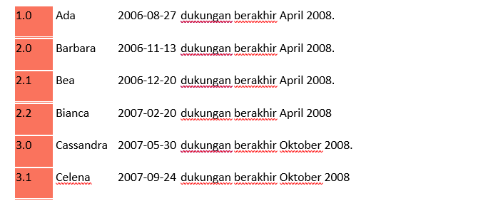
VERSION LINUX MINT OS
Linux Mint releases 2 times a year. Each Linux Mint release is given a version number and code name that uses the names of women and always end in "A" (example: Linux Mint 14 Bianca, 14 is the version number and Bianca is the code name ending in “A").

Slide 7
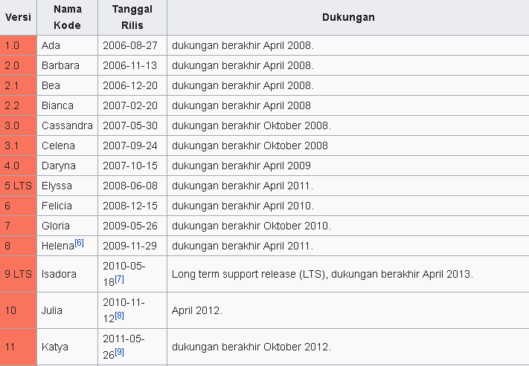
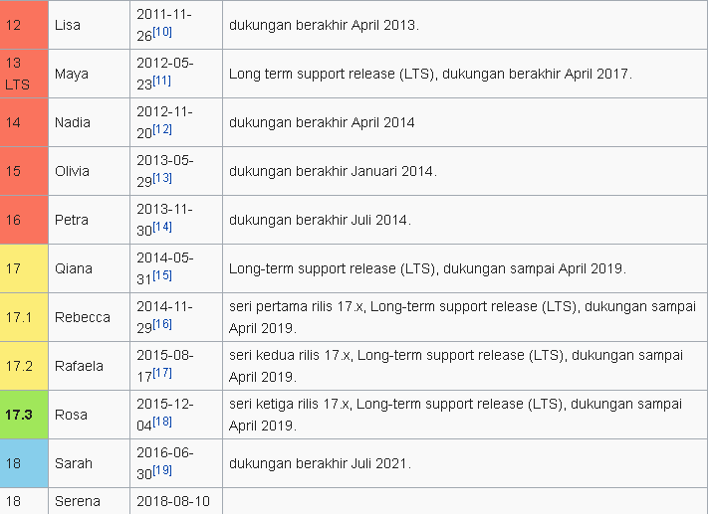
VERSION OF LINUX MINT OS

Slide 8
Features of Linux Mint OS
Desktop Sharing
Firefox Web Browser
Sun Java 6 Web Start
Thunderbird Mail
XChat IRC
Banshee
Brasero
GNOME Mplayer
Movie Player
Sound Recorder
VLC Media Player
Volume Control
GRAPHIC
OFFICE
Document Viewer
GIMP Image Editor
gThumb
Image Viewer
Simple Scan
INTERNET
LibreOffice Base
LibreOffice Calc
LibreOffice Draw
LibreOffice Impress
LibreOffice Writer
SOUND & VIDEO

Slide 9
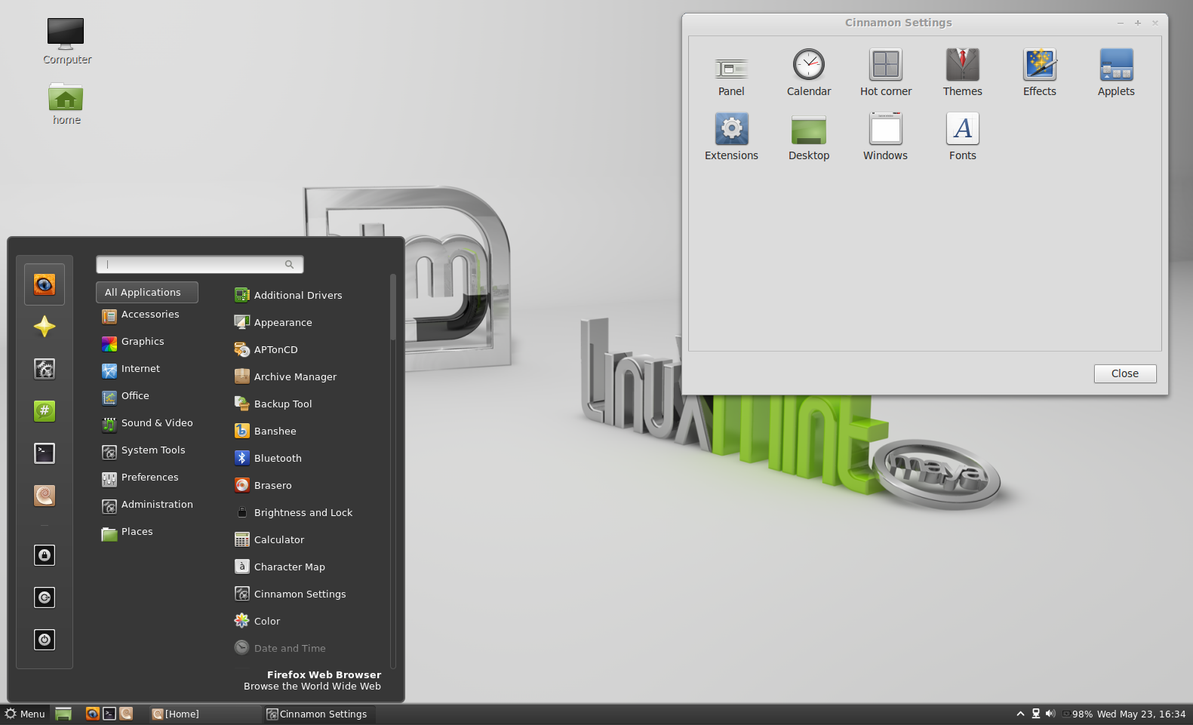
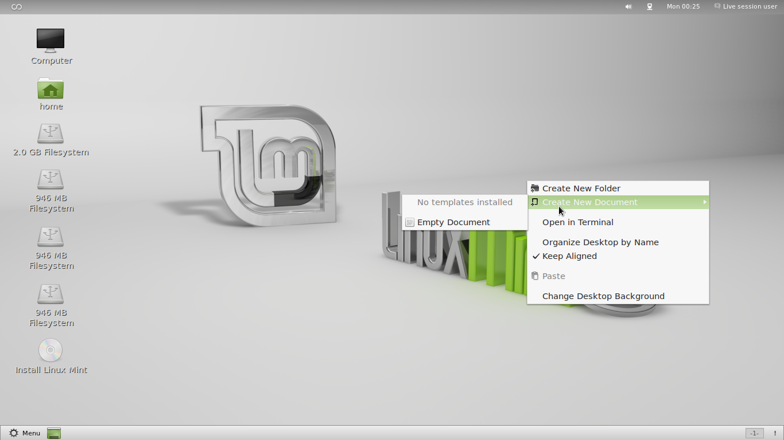
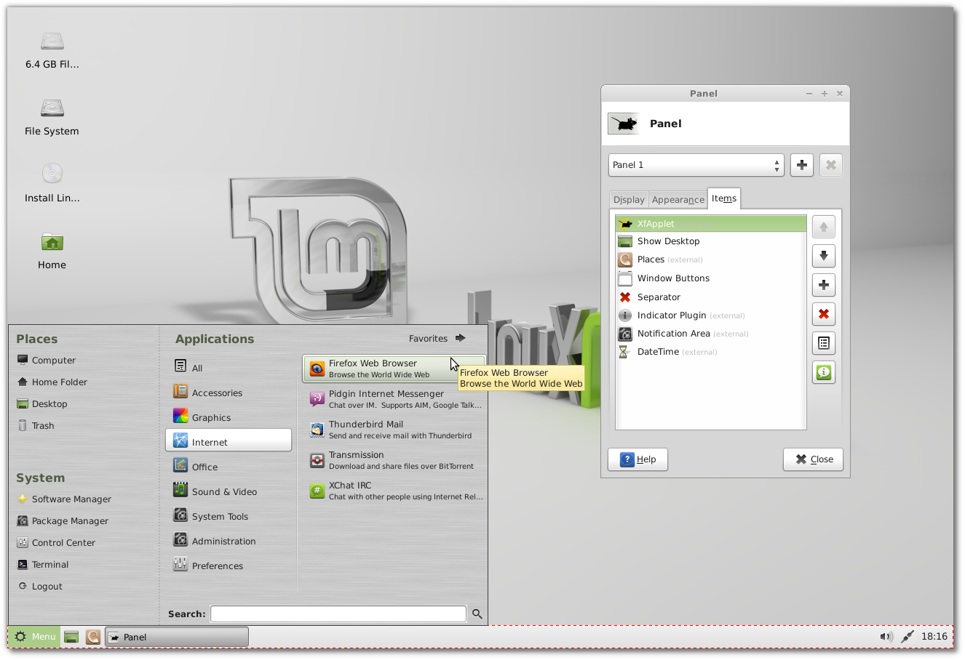
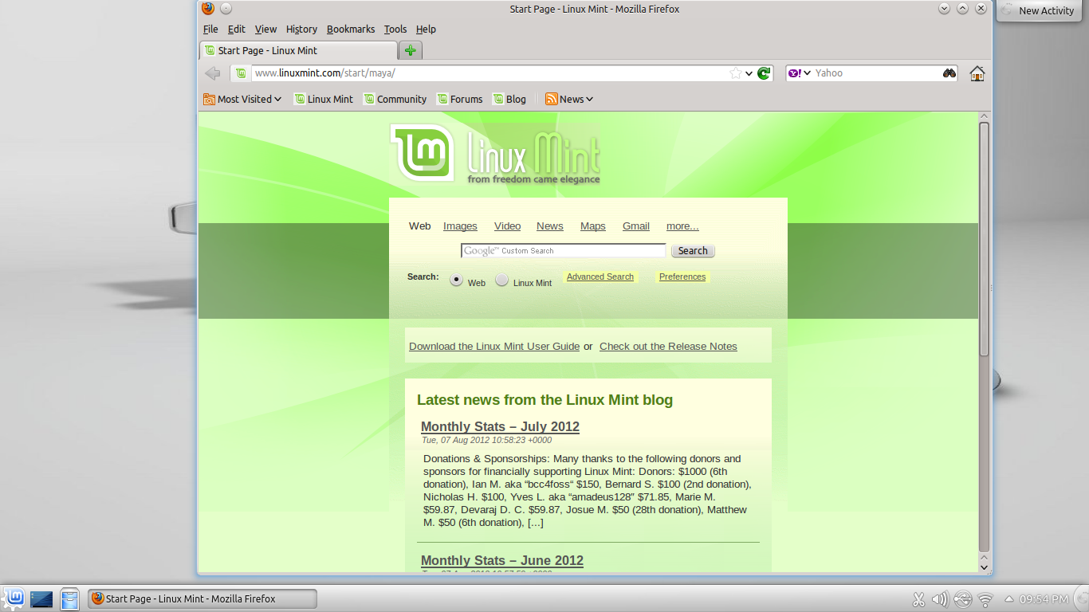
Cinnamon and Mate
CINNAMON
MATE
Cinnamon is a desktop that is very beautiful and elegant, and is perfect for those of you who like fancy desktops. With a luxurious look, of course Linux Mint Cinnamon will be very good if your computer hardware specifications are fairly mode.
Mate, is a simple and lightweight desktop developed from GNOME 2. Mate can be enhanced with luxurious effects by installing CCSM applications. Mate works well in modern and old hardware specifications.
XFCE
KDE
In addition to using the Cinnamon and Mate desktop, Linux Mint also offers KDE and XFCE desktops. So that with the presence of a varied desktop will give you a freedom to choose Linux Mint in accordance with the hardware specifications you have.

Slide 10
CONCLUSION AND SUGGESTION
CONCLUSION
SUGGESTION
Linux Mint will continue to be an elegant, 100% free operating system and Linux operating system based on the Ubuntu operating system. This operating system offers paid to both companies and individuals.
Hopefully with the development of increasingly advanced technology, the development of Linux users is also increasing. And this operating system can make it easier for users to install and operate the Linux Mint Operating System.

Slide 11
THANK YOU FOR WATCHING!
ANY QUESTIONS?

